Slide 1

Care Pay Ltd
Hanga Pitchfest 2024 Pitch Deck
Telephone
Address
Website
September 2024
+250788203065
Kigali, Rwanda
Regional ICT Center of Excellence Bldg Plot No A8
www.carepay.rw

Slide 2
TABLE OF CONTENT
CarePay PITCH DECK PRESENTATION
01
06
What we believe in
Business Model
02
07
Problem Statement
Competition
03
08
Solution
Funding Status
CarePay Ltd
04
09
Market Size
CarePay Dream Team
05
Product Traction

Slide 3

WHAT WE BELIEVE IN
Product
CarePay System
Mission
CarePay empowers healthcare providers and insurers through seamless, AI-driven claims processing automation, accelerating reimbursements and fostering trust between healthcare providers and insurers.
Vision
CarePay aims to create a new era in African healthcare as the most trusted platform for automated claims processing, relied upon by insurers and healthcare providers, ensuring swift claim processing, prompt payments, and empowering providers to deliver exceptional care free from financial barriers.

Slide 4

PROBLEMS
WE WILL SOLVE THE BELOW PROBLEMS
01
Chronic delays of claims payments
Insurance claims are submitted on a monthly basis, but claims processing and payments can take between 2 to 12 months to be processed.
In 2022, even major medical insurers were banned by Rwanda Medical association for unpaid claims lasting up to 12 months.
02
Financial strain and operational setbacks
03
Paper-Based Claims: A Barrier to Efficiency
Clinics and hospitals are left with prolonged unpaid bills, affecting their ability to deliver quality care.
The long waiting periods disrupt cash flow, pushing healthcare providers to their limits.
Insurance claims officers are overwhelmed with ten of thousands of paperwork, reviewing, analyzing, checking for fraud, and validating claims.
The current system is too time-consuming, leading to bottlenecks and delayed payments.

Slide 5

CarePay is the Solution
01
Real-Time Submission
CarePay allows providers to submit claims instantly, eliminating the monthly wait for claim submission
02
AI-Powered Adjudication
Our AI evaluates and processes claims with speed and precision, drastically reducing delays.
03
Fraud Detection
05
Dynamic Claims Prioritization
Using machine learning, CarePay helps insurances detects fraudulent claims, reducing insurer losses
AI can prioritize claims based on complexity or risk, ensuring that simple, low-risk claims are processed and paid quickly, while more complex ones get extra attention.
04
Automated Payment Processing
06
Seamless Integration
Claims are reviewed, approved, and paid automatically, making delayed reimbursements a thing of the past.
Our platform integrates smoothly with both healthcare providers' and insurers' systems, reducing friction and administrative burden.

Slide 6



MARKET SIZE
Rwanda Private Medical Facilities Association (RPMFA)
CarePay Market: Nationwide Reach
Represents around 200 private hospitals, polyclinics, specialized clinics, and general clinics in Rwanda. In 2022, RPMFA banned some insurers for delayed payments, showcasing their influence in healthcare.
Public Health Providers
Rwanda has a network of 1,700 health posts, 500 health centers, 42 district hospitals, and 5 national referral hospitals, providing vast potential for digitized claims processing. (Source: RDB, 2024)
Insurance Companies
Rwanda has 16 licensed insurers, with 15 offering medical insurance (both public and private), presenting a significant market for CarePay. (Source: BNR, 2024)
Our solution affects the services provided to 90% of Rwanda’s 13 million population, as 90% of Rwandans are insured. We target health providers—hospitals, clinics, health centers, and pharmacies—that work with insurance companies across the country, along with their corresponding insurers.
In-house Insurances
Major institutions like Bralirwa, Equity, CIMERWA, Urwego, RBA, PSF, and the Rwanda Bar Association also manage in-house insurance, representing additional market opportunities.

Slide 7


CarePay Path To Success
Future
Future
1
2
3
4
5
6
Conceptualization Research
Prototype Development
Raising Seed Capital
MVP Development
Product Iteration & Improvement
Full Launch
Problem definition
Market Research
Idea Validation
Feature Definition
Build Initial Prototype
User Testing
UI/UX Design
Refinement
Secure Seed Funding for MVP / Hanga Pitch
Investors Outreach
Use Funds to Hire Developers
Launch MVP
Beta Testing
Integration
Compliance & Security
AI Optimization
User Feedback Loop
Performance Optimization
Official CarePay Launch
Marketing Campaign
Training & Support

Slide 8
CarePay Revenue Model
CarePay Products
Description
Prices
CarePay HMIS | Free HMIS for public/private hospitals | No cost Claim submission option will be purchased
CarePay Bridge API | API integration HIMS Cleaned Claims Data Unlimited API Calls | 1 Million Rwf/ month
CarePay Analytics + Payment Service | Automated claims adjudication Fraud detection Claims Payment | 4 million Rwf / month Transaction fees will be applied based on Payment Gateway
CarePay Insure | Insurance management system Automated claims adjudication Fraud detection Claims Payment | 7 Million Rwf/month 1000 Rwf per card Transaction fees will be applied based on Payment Gateway

Slide 9

Competition
Competitor 1: Smart System (Kenya)
What They Offer: Insurance Management System, Biometric identification, manage memberships, cards, and policies. Limitations: Expensive, No digital claims submission or analytics. CarePay Advantage: More affordable, with additional features like real-time claims submission and fraud detection.
CarePay win the competition easily
Competitor 2:Insurance Internal Systems
Competitor 2:
What They Offer: Manage memberships, cards, and policies. Limitations: No digital claims submission or analytics. CarePay Advantage: Bridge API enables digital claims submission and analytics.
Competitor 3: Hospital Systems (Open Clinics & Open MRS)
What They Offer: Free, open-source hospital management systems. Limitations: No automated claims submission. CarePay Advantage: CarePay integrates to automate claims submission and reduce delays.
CarePay easily outcompetes Smart with lower costs and more features.
The first Rwandan platform to connect healthcare providers and insurers seamlessly.
Offers automated claims submission, AI adjudication, and fraud detection.
Competitor 4: EdenCare Insurance Internal System
Competitor 4:
Competitor 1: Hospital Systems (Open Clinics & Open MRS)
What They Offer: Insurance Management System with AI-powered claims analysis. Limitations: No digital claims input. Humans manually input data from paperwork into the system. CarePay Advantage: Bridge API provides digital claims data, speeding up claims processing.

Slide 10
Funding Status
CarePay Ltd
Currently CarePay is self-funded 100%
Current Status: CarePay is currently self-funded by the team.
No External Funding Yet: We have not raised any external funding so far.
Future Goal: To scale our operations, we are seeking seed capital to:
Accelerate product development.
Expand our team.
Ensure a strong market entry.
80% | Prototype Development & MVP
10% | Conceptualization and Market Research
10% | Operational Costs

Slide 11

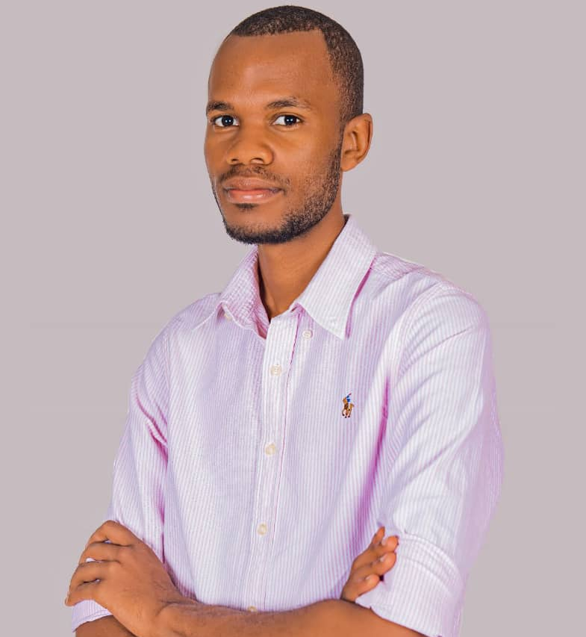
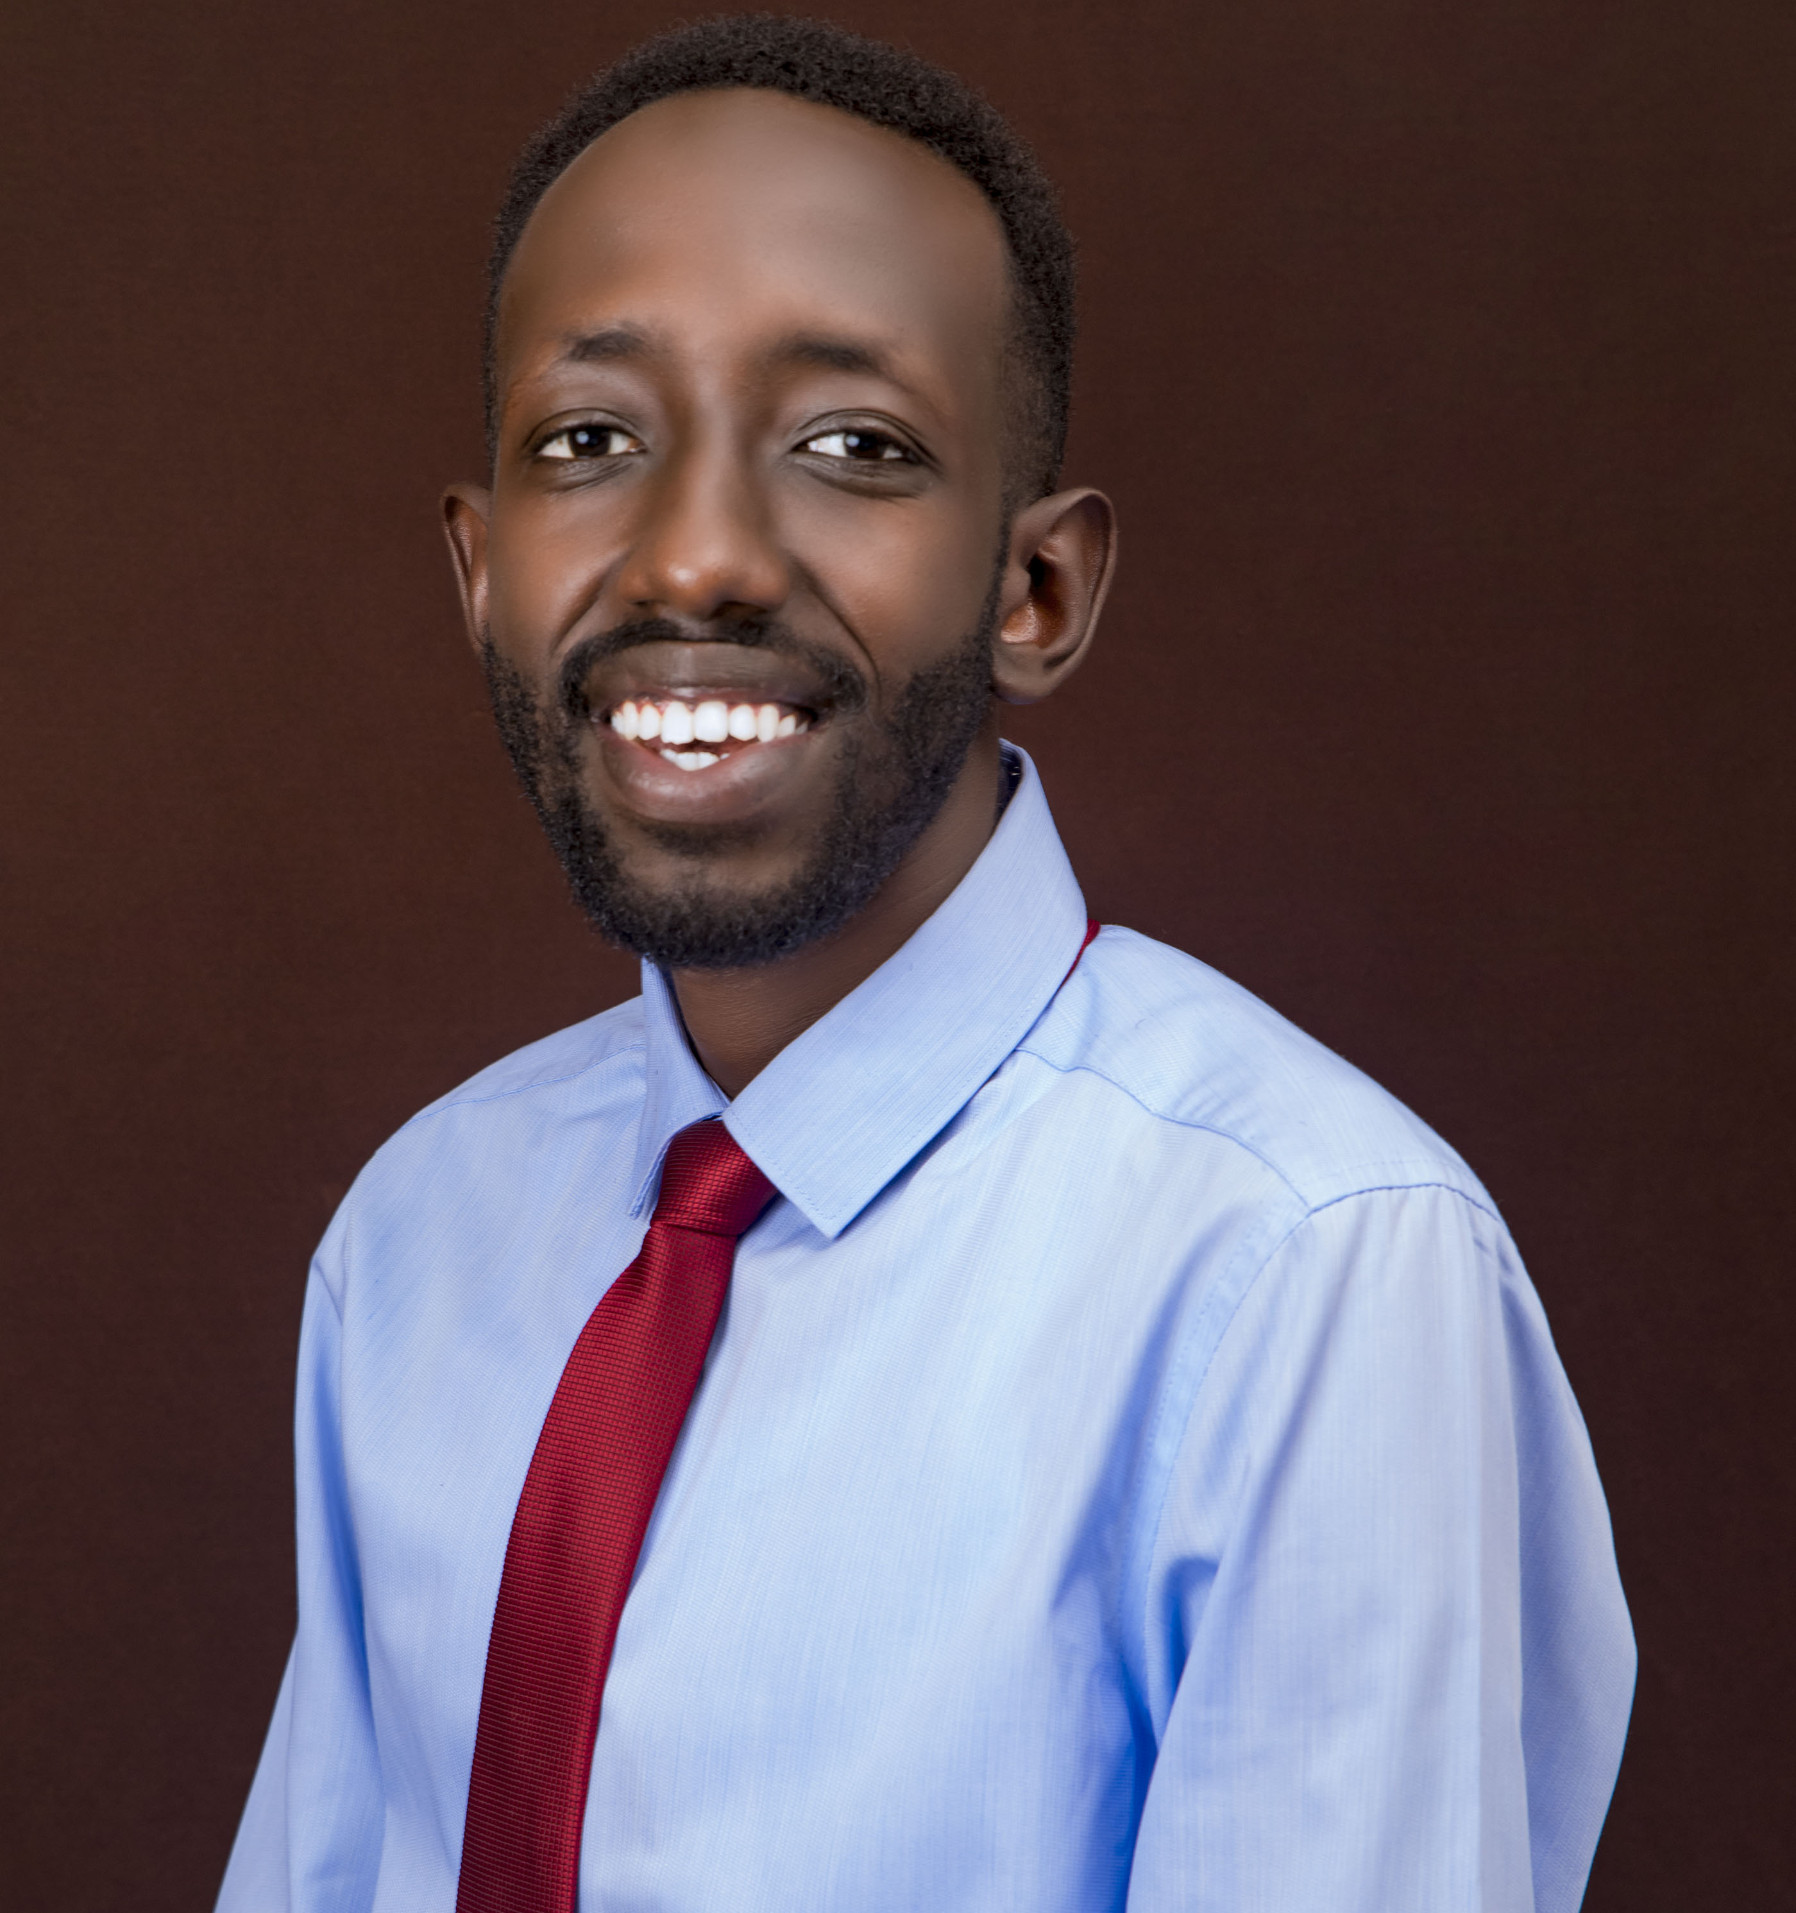

CarePay Dream Team
The level of expertise and personalized attention to our unique needs has made them an invaluable partner.
Founder & CEO
Founder & CTO
Health Tech Specialist
Medical Claims Specialist
Maurice BIGIRIMANA
Patrick IRADUKUNDA
David MANZI
William G NAYITURIKI
An expert in digital transformation and cybersecurity, currently the Manager of Application Security at the Bank of Kigali. He holds a Master’s in IT from Carnegie Mellon University (CMU) and has served as a teaching assistant in digital strategy at CMU. His expertise in secure software development and passion for digital transformation drive his commitment to innovation.
With a Master’s in IT from Carnegie Mellon University, he brings over five years of expertise in web, mobile app, and script development. His experience spans AI and machine learning research at CMU, where he contributed to cutting-edge projects, positioning him as a key force behind CarePay’s technical innovations.
an Application Specialist for the Health Management Information System (HMIS) at King Faisal Hospital, holding a Master’s in IT from Carnegie Mellon University. He specializes in customizing HMIS to meet user requirements and improve efficiency. With a strong foundation in healthcare technology, David plays a pivotal role in optimizing CarePay’s integration with existing health systems.
Bringing over 4 years of experience as a Medical Claims Analyst, William currently works at Prime Insurance Ltd, after honing his expertise at the Rwanda Social Security Board (RSSB). With a Bachelor’s in Nursing and a Master’s in Public Health, William’s knowledge ensures CarePay's solution is designed to automate claims processing with accuracy and speed.
Murad Naser

Slide 12
THANK YOU
FOR YOUR NICE ATTENTION
Telephone
Address
Website
September 2024
+250788203065
Kigali, Rwanda
Regional ICT Center of Excellence Bldg Plot No A8
www.carepay.com

